Slide 1

Repeatability of Cordwood Combustion Particulate Measurements
Summary of Studies with the Condar Portable Dilution Tunnel
Norbert Senf
January 19, 2018
mha-net.org

Slide 2
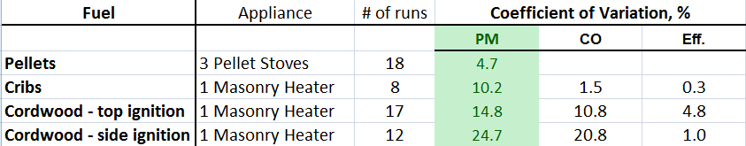
Summary of Results
Green column shows the repeatability of wood smoke particulate (PM) measurements as measured with the Condar.
Pellet stoves were the most repeatable at plus or minus 4.7%
With cordwood under carefully controlled conditions, repeatability was 3 - 5X worse than pellet stoves.
Cribs made from dimensional lumber were 2X more repeatable than cordwood (in a masonry heater).
Cribs had roughly 50% higher PM emissions than cordwood in a masonry heater.
Coefficient of variation = standard deviation/average
X 100 gives a percentage value for variability
(lower is better)

Slide 3
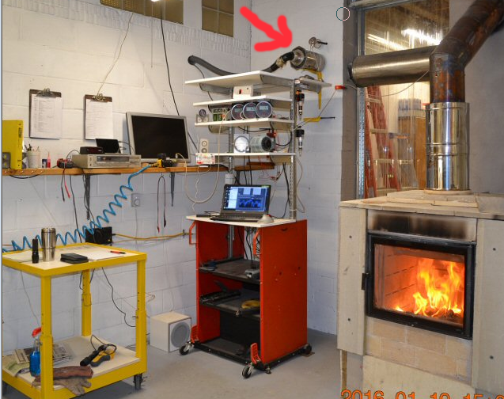
Condar Portable Dilution Tunnel
MHA Lab
Arrow points to Condar portable dilution tunnel, mounted on the chimney. It pulls a smoke sample from the stack, dilutes it with air and pulls it through a filter which is then weighed.
Other instruments measure flue gas temperature, flue gas composition and burn rate.

Slide 4
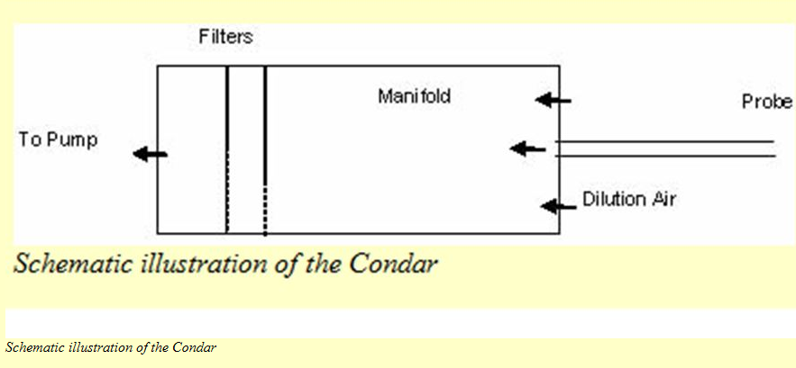
Condar schematic

Slide 5
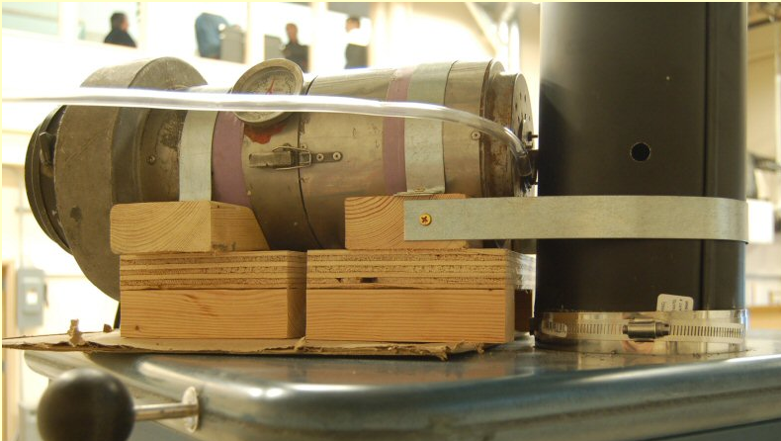
Condar Portable Dilution Tunnel

Slide 6
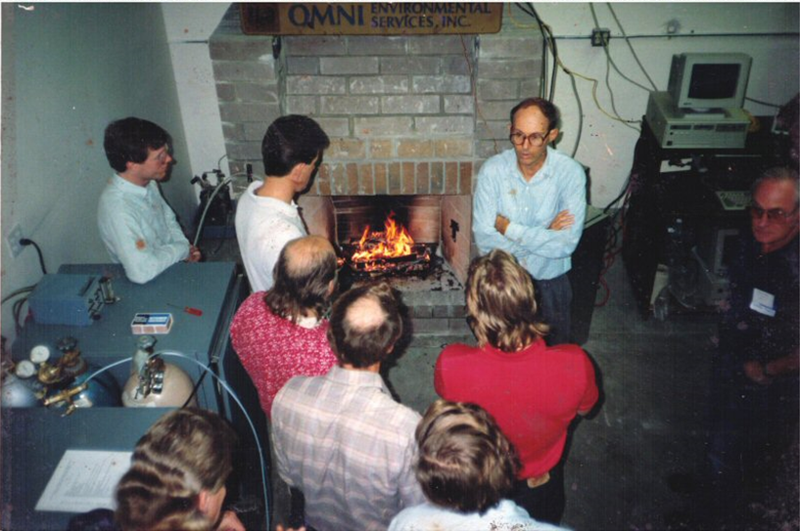
Skip Barnett, inventor of the Condar
1996 Fireplace emissions testing seminar, OMNI-Test, Oregon

Slide 7
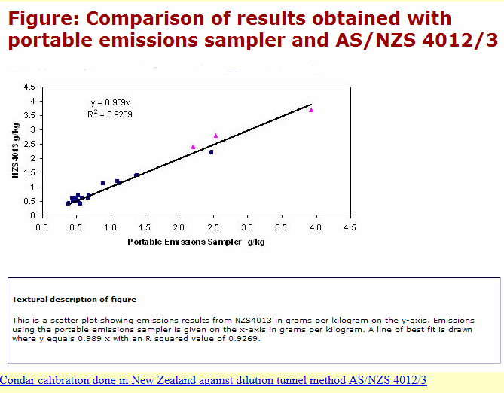
Condar used in 2006 New Zealand pellet stove field study
This study from New Zealand showed excellent correlation between PM numbers (g/kg) obtained by the Condar and by the official NZ laboratory test method (similar to EPA Method 5G) when both were run on the same stove at the same time.

Slide 8
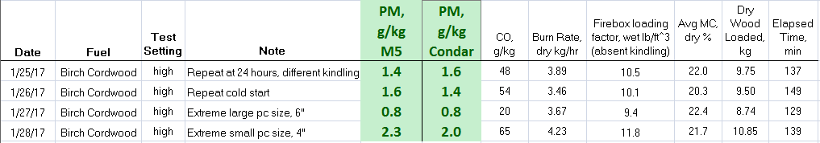
M5G Comparison – Masonry Heater
Tulikivi tested at Mark Champion’s Laboratory, February 2017
(funding by EPA and MHA)
Average difference in PM measurement
(percentage of larger number) = 9.5%
For substantial test variation, for example large wood and small wood, the differences are clear and in agreement with both test methods

Slide 9
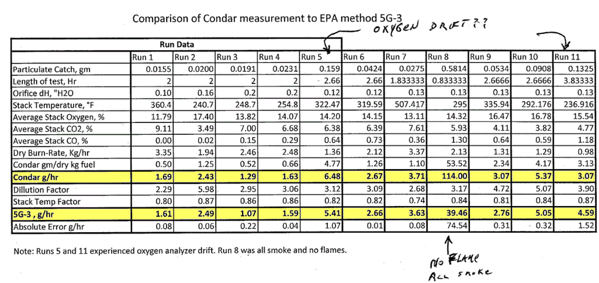

M5G Comparison – EPA stove
Yellow rows: Comparison of PM numbers for 11 runs of an EPA-certified stove, between EPA method 5G-3 and the Condar portable dilution tunnel.

Slide 10
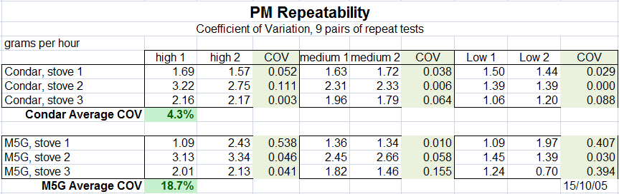
1.) Pellet Stove PM Repeatability
EPA Method 5G-3 vs. Condar Method
This was a comparison using short sample times, and a resulting low catch on the filters.
The Condar 6” filters have 9X the particulate catch of the M5G 2” filters.
The Condar showed better repeatability over 18 tests on 3 pellet stoves.
This may be an issue with future testing on ultra clean stoves and needs more data.

Slide 11
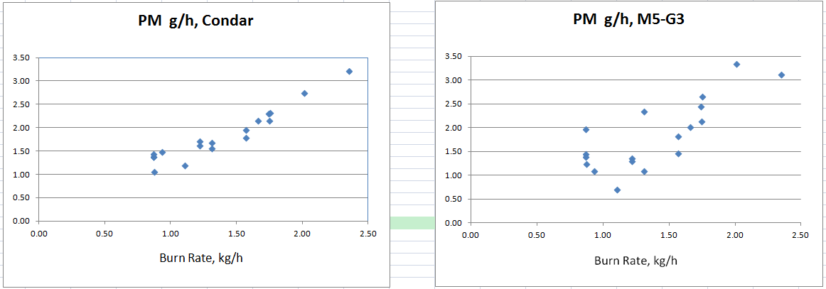
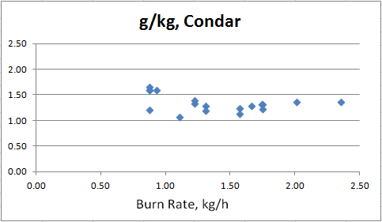
Pellet Stoves, low filter catch
On a gram per hour basis, the emissions increased with the burn rate in a linear fashion on the 3 pellet stoves (above).
On a grams per kilogram of fuel basis, the emission factor was flat (right):

Slide 12
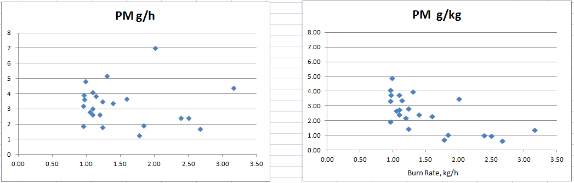
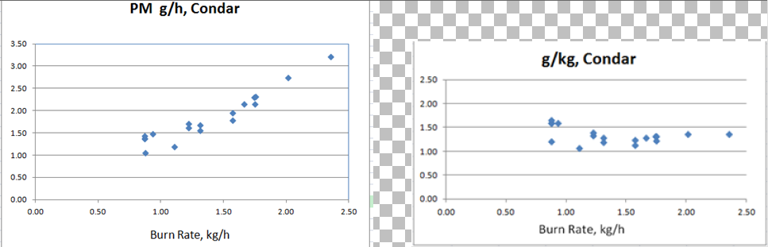
g/h compared to g/kg emissions rate emissions factor
It is clear that EPA stoves have a PM problem at low burn rates, and are fairly clean at high burn rates.
This is apparent in the rightmost graph, but not in the left graph.
Certification test data from 5 random EPA non-catalytic stoves
The more informative graph is on the right, which shows that pellet stoves do not have the low burn rate issue with PM that cordwood stoves do.
Research testing data from 3 pellet stoves

Slide 13
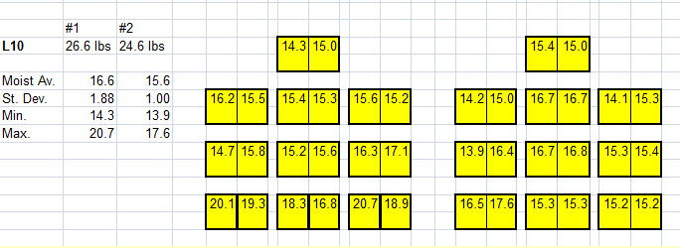

2.) PM Repeatability with dimensional lumber cribs,
Masonry heater batch burn with 2 cribs (1 repeat load)
Map for a pair of cribs that was
closely matched for moisture
with the repeat test load pair.
Time lapse – double click to repeat
(Note the reload)

Slide 14
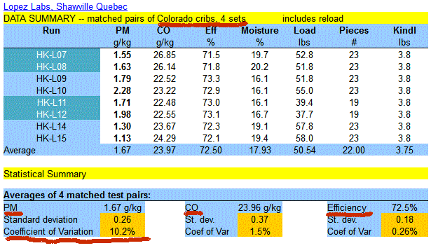
Summary of results
4” x 4” dimensional lumber fuel cribs
Repeatability for PM was 10.2%
For CO it was 1.5%
The repeatability for efficiency was ¼ of 1 % (!)

Slide 15
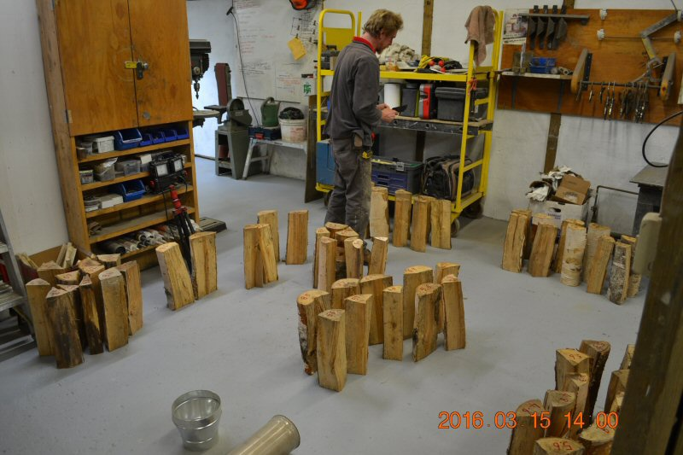
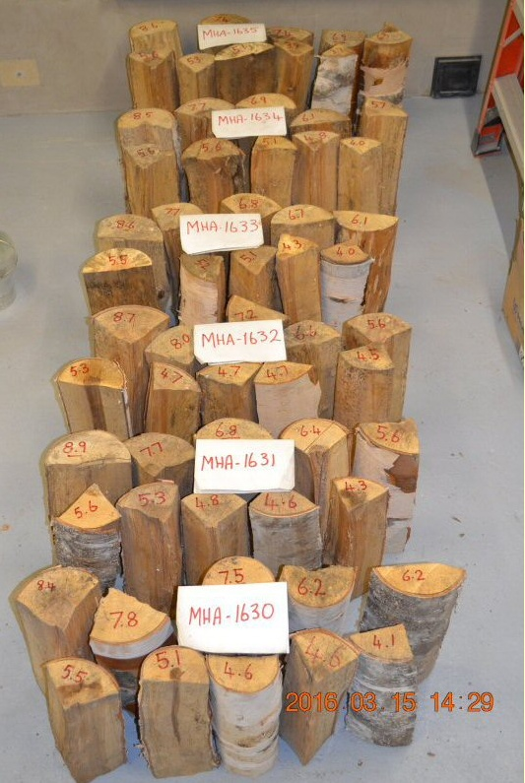
3.) Cordwood repeatability, MHA lab
Fuel loads for 6 tests were prepared simultaneously, to allow better matching of fuel pieces between loads.

Slide 16
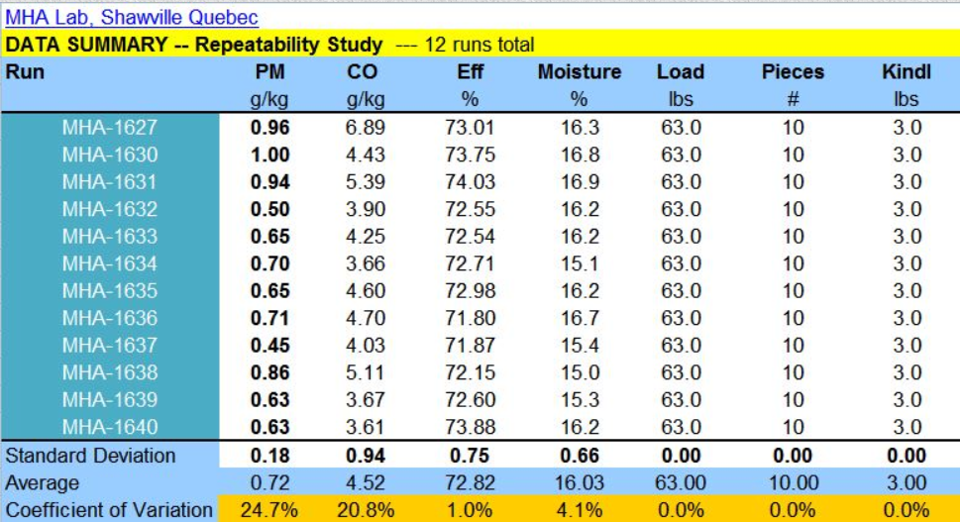
Two MHA Repeatability Studies
Cordwood in a masonry heater
22” firebox, Austrian eco-labelled air system – side ignition
PM repeatability was +/- 24.7% when the fuel batch was ignited from the side

Slide 17
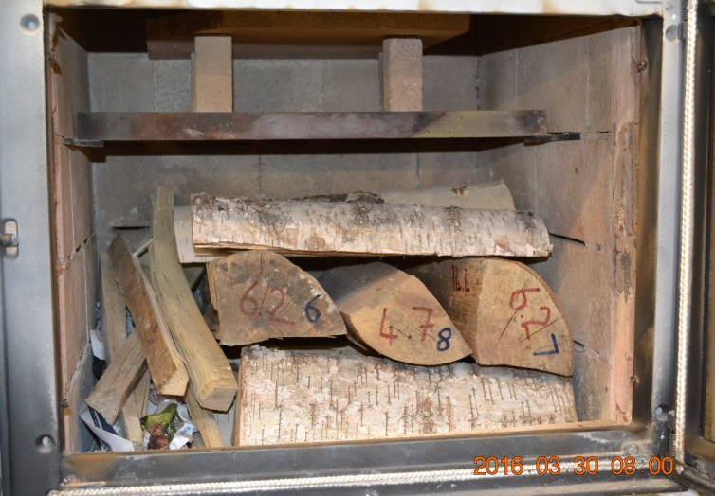
Two MHA Repeatability Studies
Cordwood in a masonry heater
22” firebox, Austrian eco-labelled air system – side ignition, W. Birch
Time lapse – double click to repeat

Slide 18
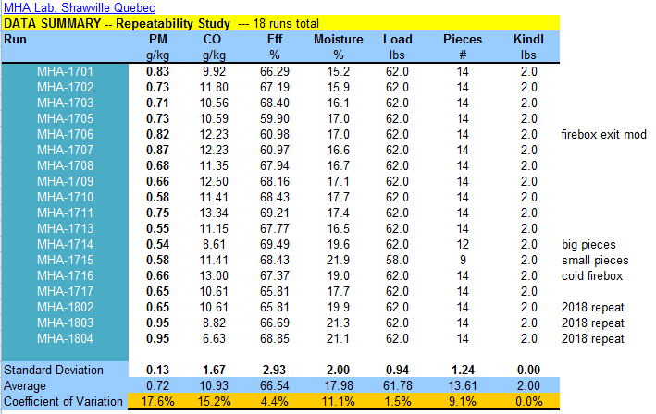
Two MHA Repeatability Studies
Cordwood in a masonry heater
22” firebox, Austrian eco-labelled air system – top ignition
Repeatability was +/- 17.6% with top ignition, compared to +/- 24.7% with side ignition.

Slide 19
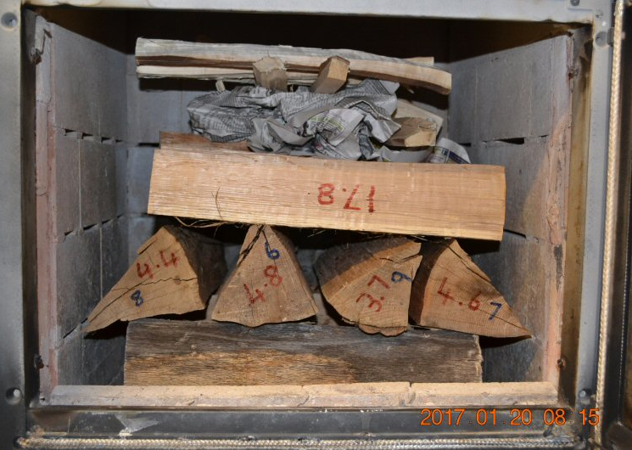
Two MHA Repeatability Studies
Cordwood in a masonry heater
22” firebox, Austrian eco-labelled air system – top ignition, Red Oak
Time lapse – double click to repeat

Slide 20
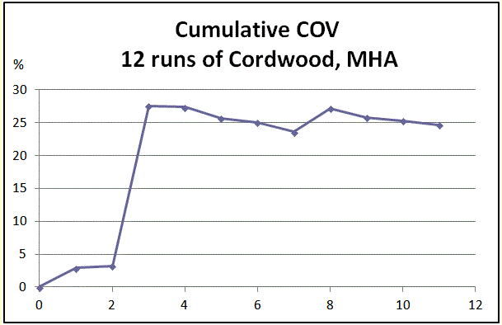
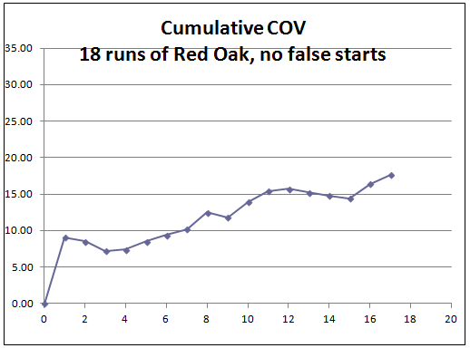
Side ignition
Top ignition
The repeatability with only 2 runs was better than 5%, but jumped to 27% on the 3rd run. It is evident from the graph that the true value is around 25%
The repeatability was around 10%, but dropped to 15% with 10 tests or more.
Conclusions:
For PM, pellet stoves had 2X better repeatability than a masonry heater fueled with cribs.
Cribs had 1.5 – 2 X better repeatability than carefully matched cordwood loads in a masonry heater.
To get a PM number of comparable quality, cordwood would need more repeat runs than cribs.

