Slide 1
Repeatability Studies with the Condar Portable Dilution Tunnel

Slide 2
Condar schematic

Slide 3
Condar used in 2006 New Zealand pellet stove field study

Slide 4
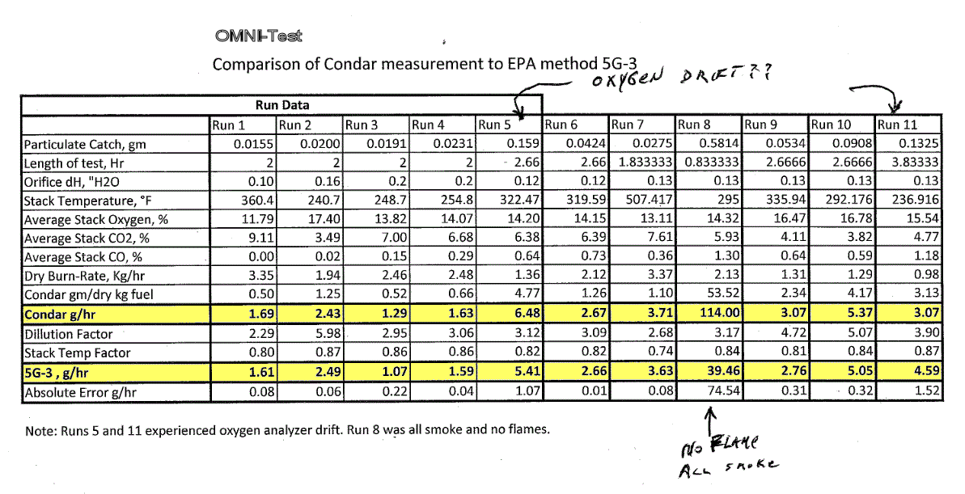
OMNI data, EPA stove

Slide 5
1.) Pellet Stove PM Repeatability M5G-3 vs Condar
Interpretation: With the shortened version of the ASTM protocol, filters were pulled for each burn rate after approx 1 hr of sampling. With the 2” M5G filters, the catch was very low . The 6” Condar filters have 9X the catch and effectively give you an extra digit of resolution.

Slide 6
Pellet Stoves, low filter catch (shortened ASTM method)

Slide 7
2.) Crib Repeatability HeatKit masonry heater, 22” (large) firebox

Slide 8
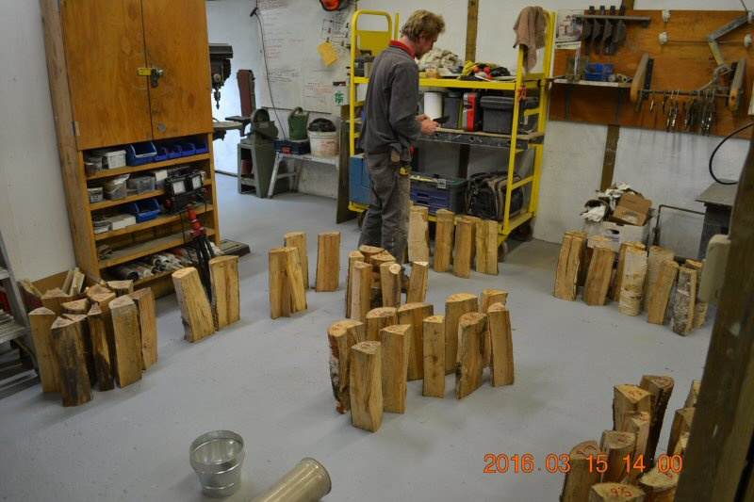
3.) Cordwood repeatability, MHA lab

Slide 9
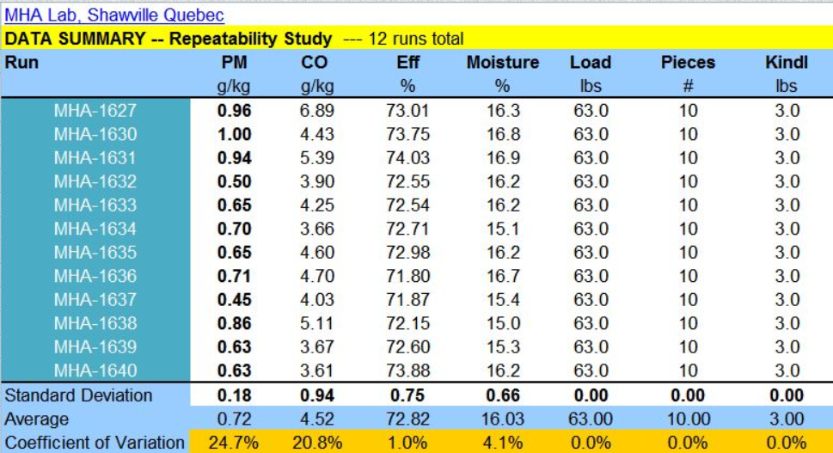
MHA Repeatability Study Cordwood in a masonry heater 22” firebox, Austrian eco-labelled air system

Slide 10
Conclusion:
For PM, pellet stoves had 3X better repeatability than a masonry heater fueled with cribs.
Cribs had 2X better repeatability than carefully matched cordwood loads in a masonry heater.
To get a valid PM number, cordwood likely will need more repeat runs than cribs.

